Slide 1

Airbnb Hotel Booking Analysis
Manav Mukeshbhai Patel
INTERNSHIP_17546440516895be537820f

Slide 2

PROBLEM STATEMENT
Analyze Airbnb booking data to uncover trends, pricing dynamics, guest preferences, and host performance to help improve decisions for hosts and enhance guest experience.

Slide 3
Project Description
Briefly introduce Airbnb's role in hospitality and describe the project focus (patterns, strategies, preferences, host performance)
Key Objectives :
1. Booking Patterns 2. Pricing Strategies 3. Guest Preferences 4. Host Performance

Slide 4

WHO ARE THE END USERS?
Hosts
Airbnb management
travelers
data analysts

Slide 5

Technology Used
Python
Google collab Notebook
Pandas
Matplotlib
Seaborn
Machine Learning

Slide 6
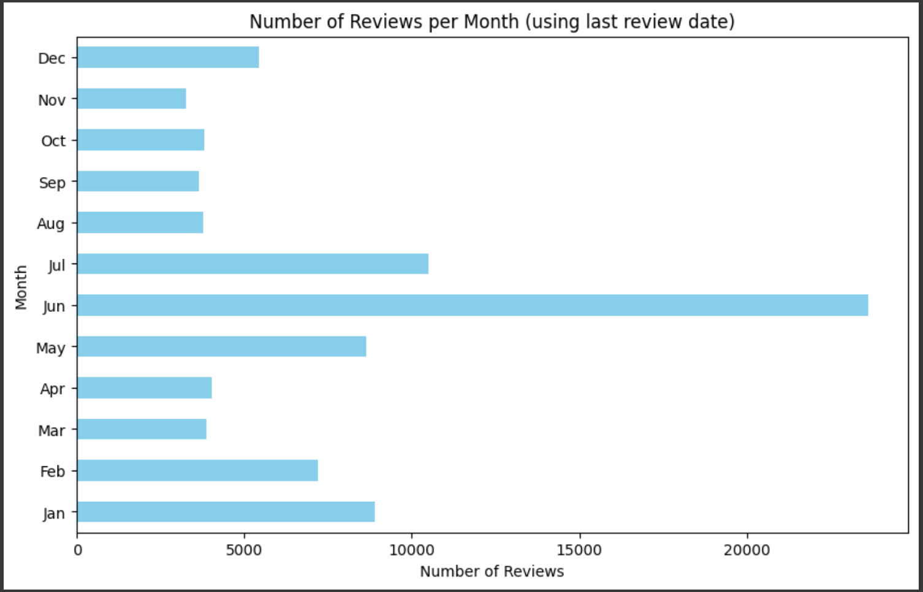
RESULTS1

Slide 7
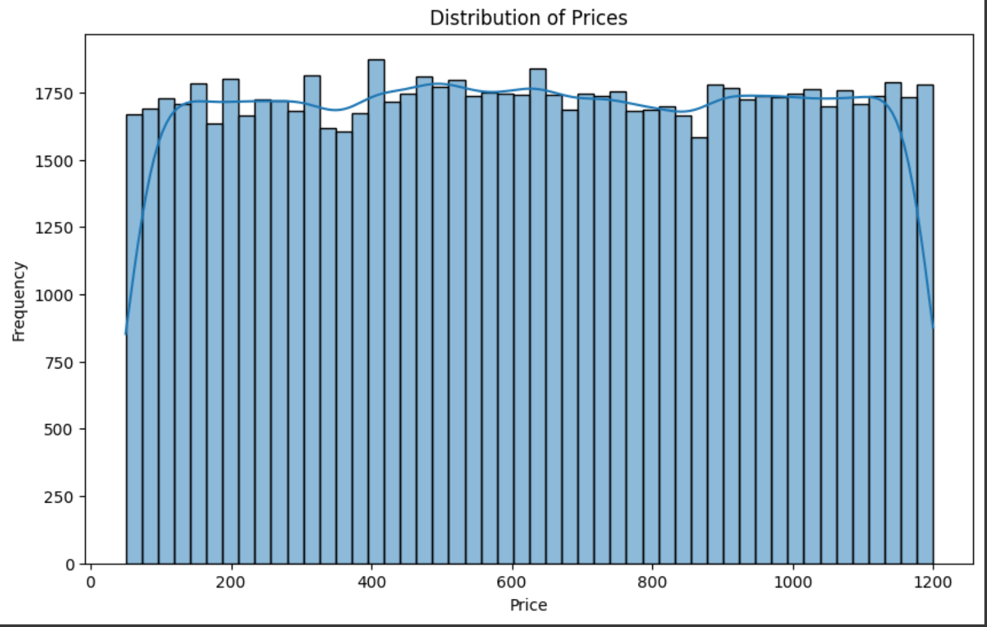
RESULTS2

Slide 8
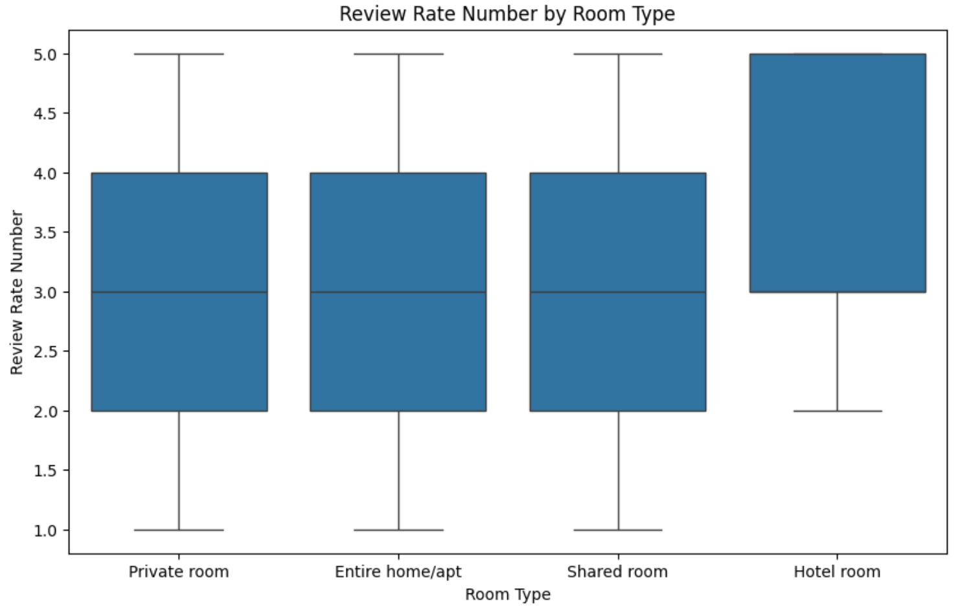
RESULTS3

Slide 9
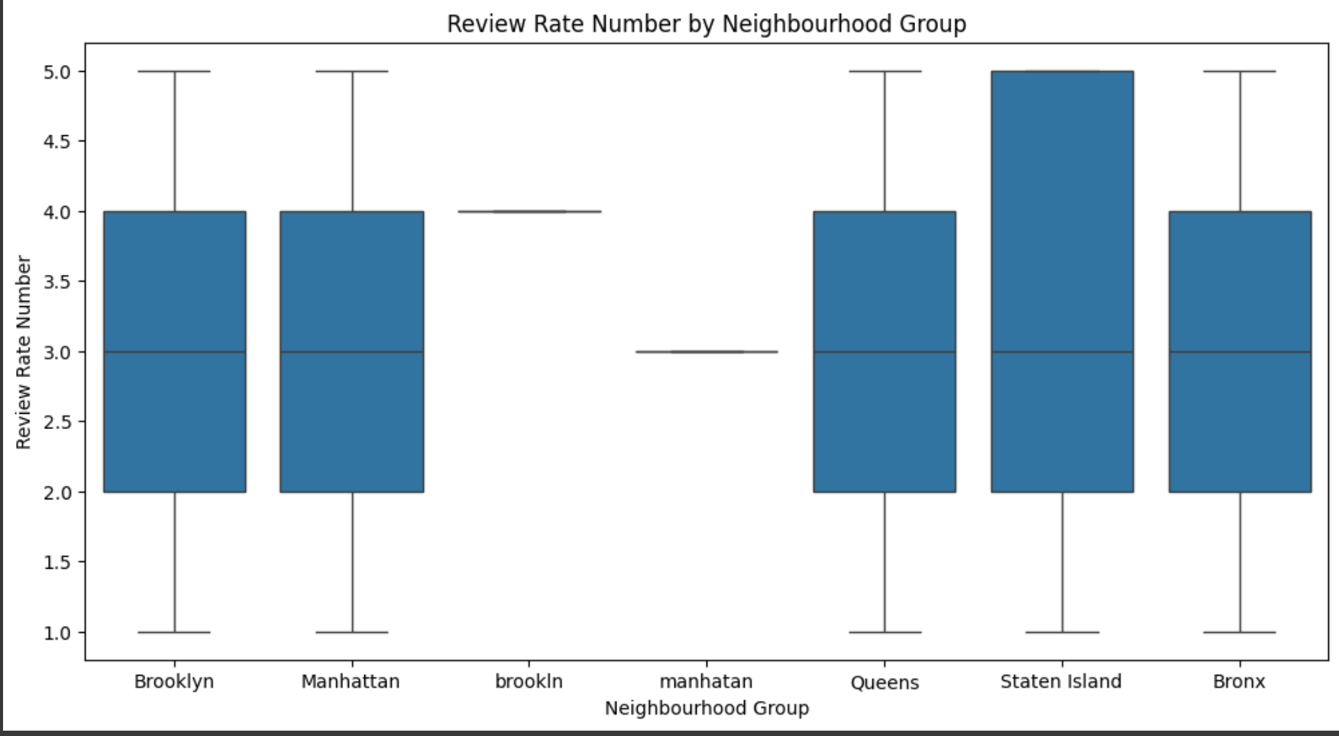
RESULTS4

Slide 10
GitHub repository
Git hub link : https://github.com/devilking5377/VOIS_AICTE_Oct2025_Manav-Mukeshbhai-Patel.git

Slide 11

Getting started with Basics of Python Certificate
[Paste your Certificate Here]

Slide 12
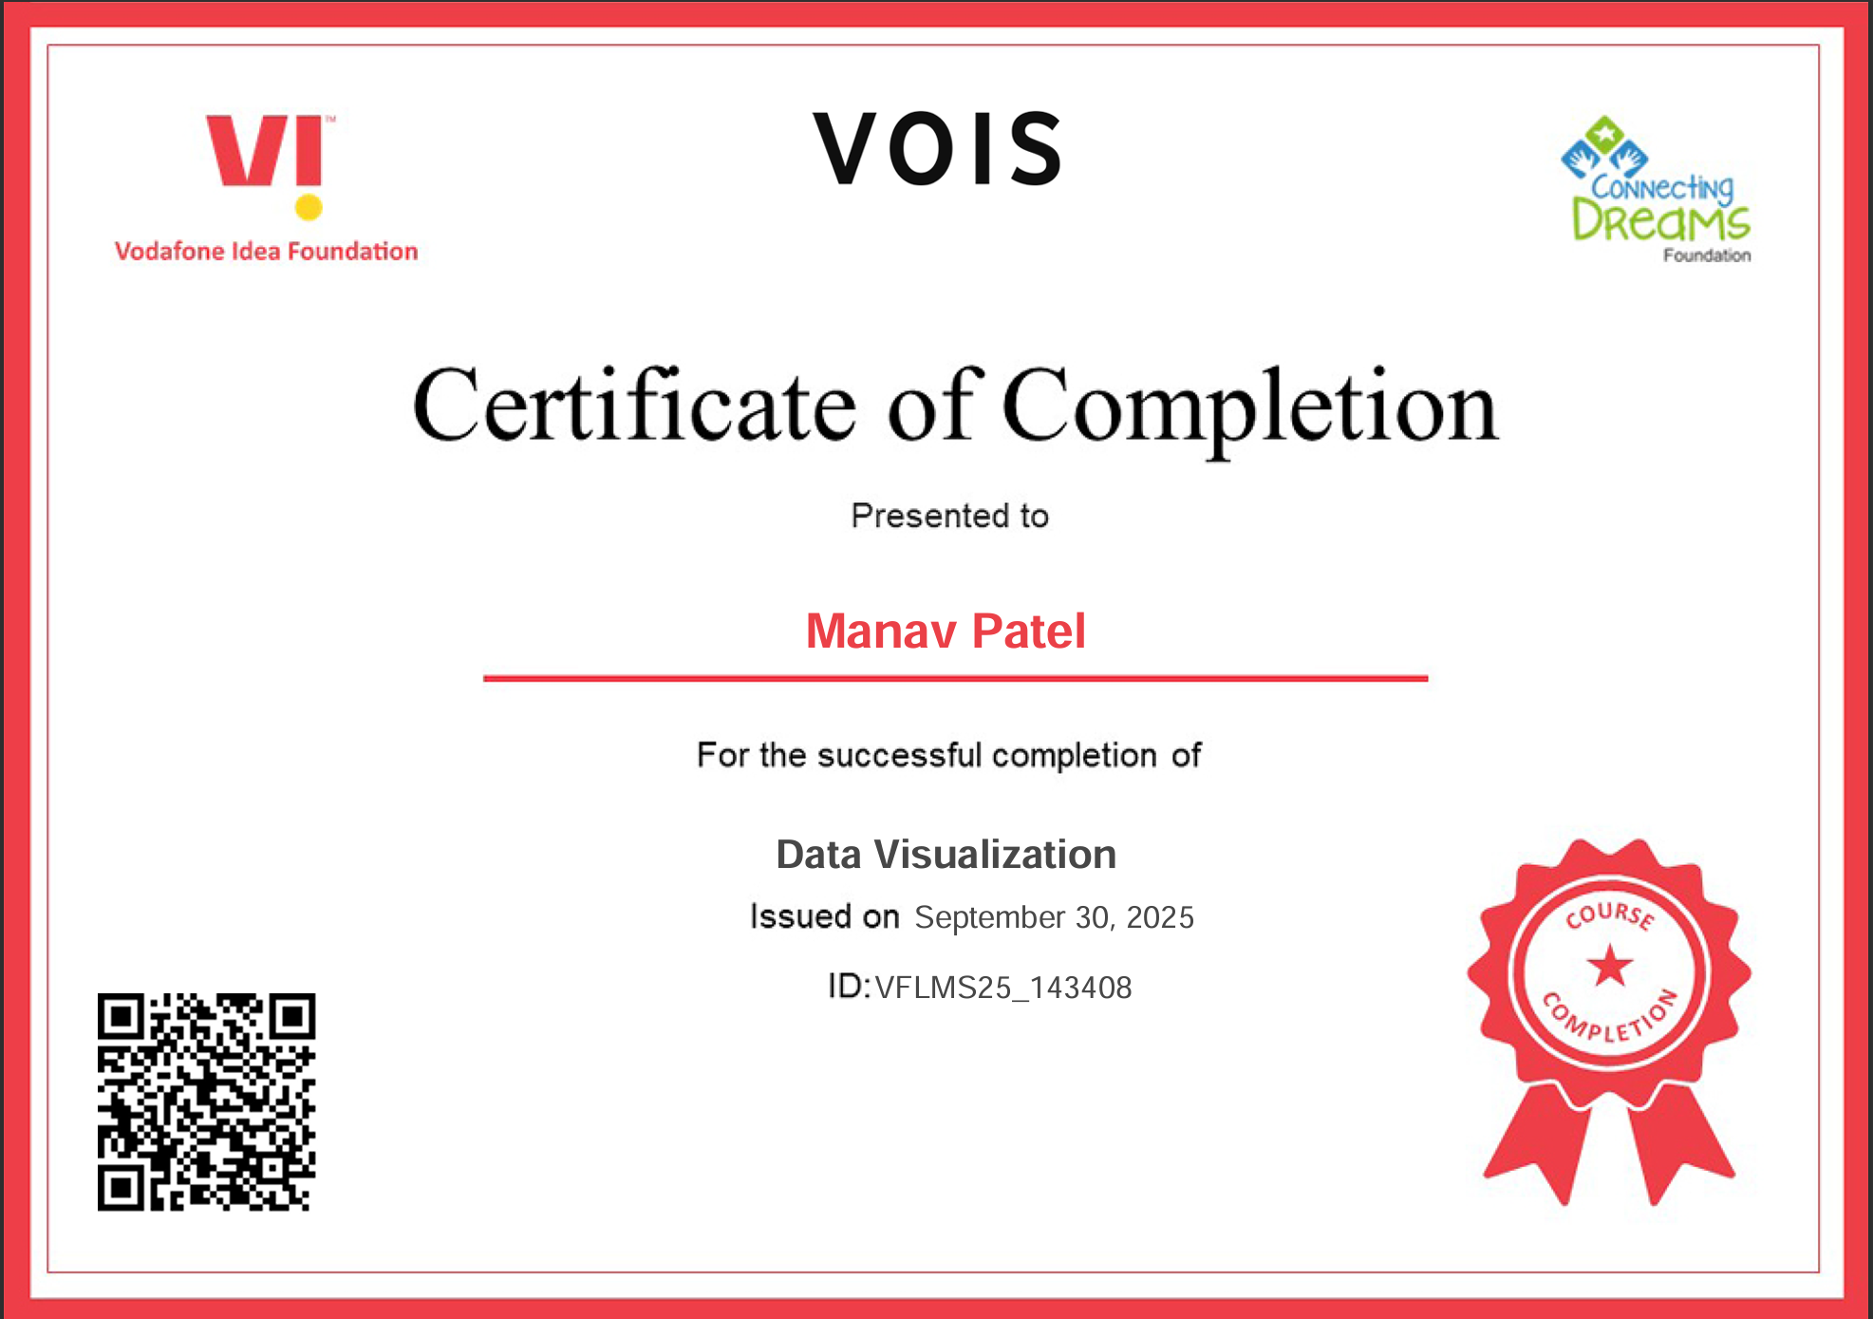
Data Visualization Certificate

Slide 13
Thank you
.
.

